Slide 1
Analyzing Correlations: Factors Influencing Personal Insurance Expenditure
By: Clayton-George Reid

Slide 2
Introduction
The analysis conducted in this research paper sought to examine the factors influencing personal and household insurance expenditure and explore the predictive capabilities of machine learning models in predicting insurance expenditure.

Slide 3
Literature Review
Hossen's Thesis (2023): Focuses on using machine learning to improve insurance policy terms, employing models like XGBoost Regression to accurately forecast insurance amounts using individual and local health data.
Systematic Review by Morid et al. (2018): A review identifying methods for predicting healthcare costs, using data from the University of Utah Health Plans, highlighting gradient boosting and neural networks for their superior predictive performance.
Contribution to the Field: Advances discussion on insurance cost prediction, integrating innovative technologies and approaches to meet the changing needs of the insurance market.

Slide 4
What are the research questions?
Investigating what variables within this dataset lead to an accurate prediction of charges, prompts the following questions:
Can we establish correlations between specific factors in our dataset and the prediction of charges?
Which variable exhibits the strongest and weakest correlations with charges?
Is there a significant difference in charges between smokers and non-smokers?
Do charges significantly differ between genders?

Slide 5
Why is the research question important?
Establishing correlations can inform both policy design and individual decision-making. For example, if specific variables are strongly correlated with higher charges, individuals and policymakers can focus on modifying these factors.
Identifying the strongest and weakest correlations helps prioritize which factors to focus on in predictive models and policy adjustments. If a variable strongly correlates with charges, it may be a key lever for cost control and risk assessment.
Understanding gender differences in charges can help in assessing fairness and equity in insurance pricing. This question addresses whether gender is a factor that influences insurance costs independently of other variables.

Slide 6
Why is the research question important?(continued)
In summary, each of these questions delves into different aspects of what impacts insurance costs. By understanding these relationships, insurers can more accurately predict costs and set premiums that are fair and sufficient to cover the expected risk. Furthermore, identifying key variables that affect charges allows for better risk stratification and personalized pricing strategies, which can lead to more competitive insurance offerings and potentially lower costs for consumers.

Slide 7
Description of Data
Variable | Observations | Mean | Std. dev. | Min | Max
Age | 1337 | 38.372 | 13.943 | 18 | 64
BMI | 1337 | 30.092 | 5.856 | 15.96 | 45.9
Children | 1337 | 1.077 | 1.222 | 0 | 5
Charges($) | 1337 | 8159.150 | 4929.644 | 1121.874 | 20984.093

Slide 8
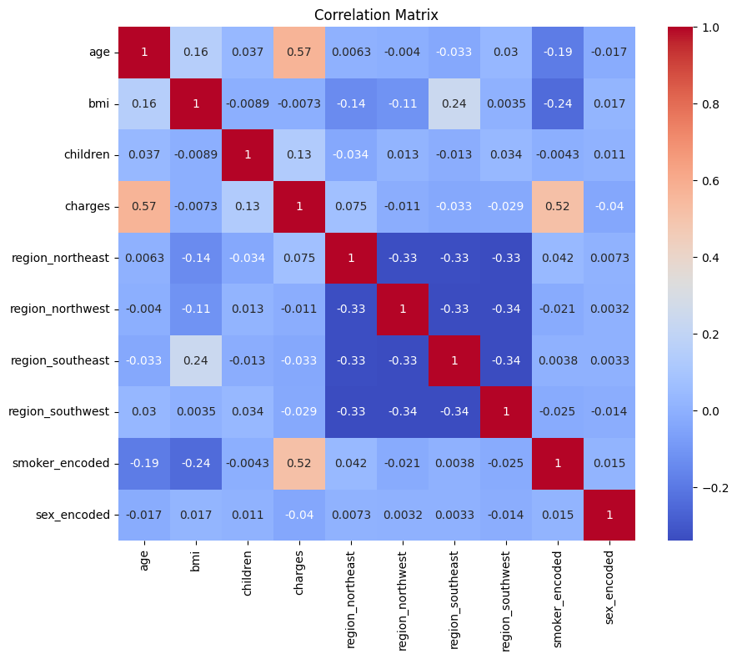
Method used to answers to the research questions
Creation of Heatmap: Developed a heatmap to analyze and visualize the correlation coefficients among various variables.
Color Intensity as Indicator: Utilized color intensity in the heatmap cells to represent correlation strength—brighter colors for stronger correlations, darker colors for weaker ones.
Key Findings: According to the heatmap, the variables "age" and "smoker" display the highest correlations with charges, indicated by a light peach color, at correlation coefficients of 0.57 and 0.52 respectively.

Slide 9
Method used to answers to the research questions (continued)
The results of the heat map are used to create the equation utilized for this study.
The equation utilized in this study for predicting charges is formulated as follows:
charges = β0 + β1 age + β2 smoker + ∈
where:
charges represent the predicted charges.
β0 denotes the intercept term, capturing the baseline charges when all predictor variables are zero.
​ β1 and β2 signify the coefficients associated with the predictors of age and smoker respectively.
Age is the predictor variable representing the age of the insured individual.
Smoke is a binary predictor variable indicating whether the insured individual is a smoker (1) or a non-smoker (0).
ϵ represents the error term.

Slide 10
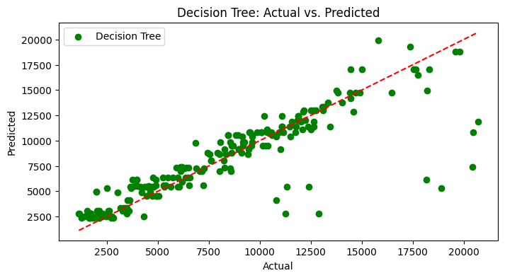
Results of Prediction
Decision Tree Prediction Graph: Features a scatter plot comparing actual insurance charges to those predicted by a decision tree model.
Accuracy of Predictions: The proximity of the green dots to the red dashed line signifies the accuracy of the model's predictions.

Slide 11
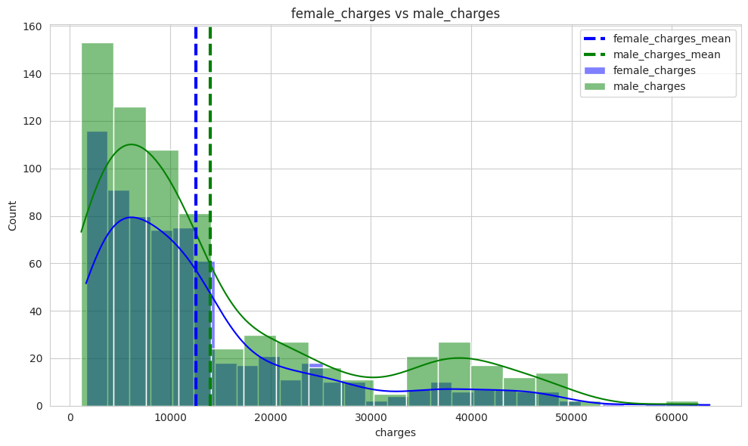
Male versus Female Charges
Both distributions are right-skewed, indicating that most charges are on the lower side, with fewer instances of very high charges.
The peak for female charges occurs earlier than for male charges, suggesting a higher concentration of females in the lower charge range.
Observations from the graph indicate that men consistently have higher usage and incur more costs than women.

Slide 12
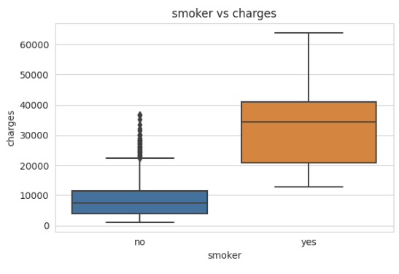
Smoker versus Charges
As expected smokers have higher expenditure than non-smokers. With non-smokers having exempts.

Slide 13
What are the main findings?
The results indicate that age consistently emerges as the most influential predictor of insurance charges, with higher importance scores compared to smoker status in all models. This underscores the significance of age demographics in determining insurance premiums. The findings contribute valuable insights to insurance pricing strategies and risk assessment methodologies, highlighting the need to consider demographic factors when pricing insurance policies.
We also see the average count as well as the amount spent by males and females with men being higher in both expenditure and usage. With men consistently having higher usage and costing more than women.

Slide 14
What could be done in the future?
Future research could delve into:
The interaction effects between demographic and lifestyle variables, as well as the incorporation of additional data sources such as telematics data and social media activity.
Investigate the implications of emerging technologies such as artificial intelligence and blockchain on insurance pricing and risk assessment could provide valuable insights into the evolving landscape of the insurance industry.

